Slide 1

Inventory Management Expert
Professor：Siva Dosapati
Member：Dora, Lei Zhou, Jia, Khutaijia Shariff, Kerwin

Slide 2

Contents
Project Proposal
1
Implementation Process
2
Patterns Design
3
4
Optimizations
IME

Slide 3
Project Proposal
Develop a backend inventory system for car dealers to efficiently manage their car records
The inventory allows dealers to add, delete and modify car records
Implementation of functionality to filter cars according to their attributes
Developed the functional implementation for the designed model using Java Swing in Eclipse.
IME

Slide 4
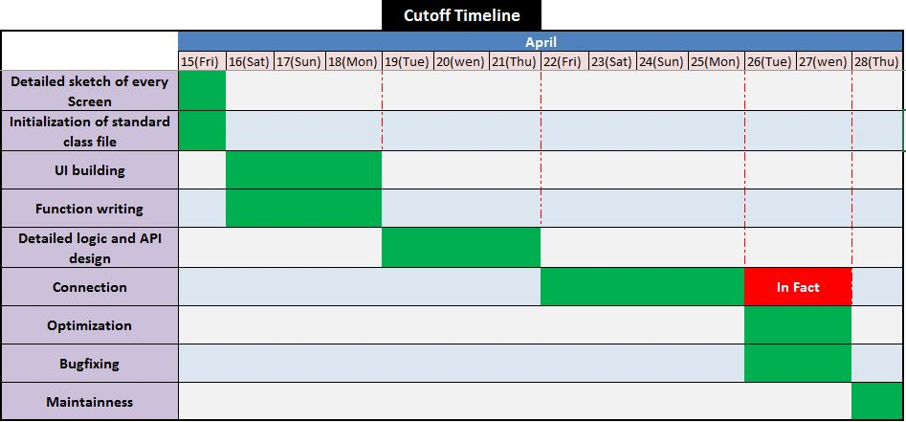
Implementation Process
IME

Slide 5
Patterns Design
Table
RadioButtonRender
RadioButtonEditor
Car
CarFilterManager
xxxFilter();
…
CarFileManager
CarSearchManager
Screen_CarList
Car
Files
readCar();
writeCar();
listCar();
sortCar();
Filter conditions…
JTable….
CarDataManager
addCar();
deleteCar();
modifyCar();
Dealer
DealerManager
Screen_Main
Screen_AddRecord
Screen_ModifyRecord
Dealer
File
getDealerName();
IME

Slide 6
Optimization
Better class design and implementation
Using JRadioButton for selection of records for modification and deletion
Deletion of multiple records with one click of delete button
IME

Slide 7

Thanks

